Slide 1
Large vocabulary ASR
Most slides come from http://www.inf.ed.ac.uk/teaching/courses/asr/2020-21/asr05-hmm-algorithms.pdf
Ying shen
School of software engineering
Tongji university

Slide 2
HMM Speech Recognition
Decoded Text
(Transcription)
Recorded Speech
Signal Analysis
Acoustic Model
Search Space
Language Model
Training Data

Slide 3
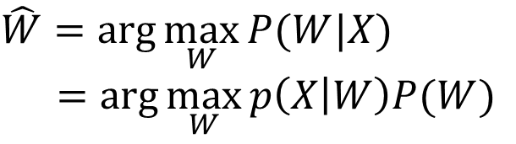
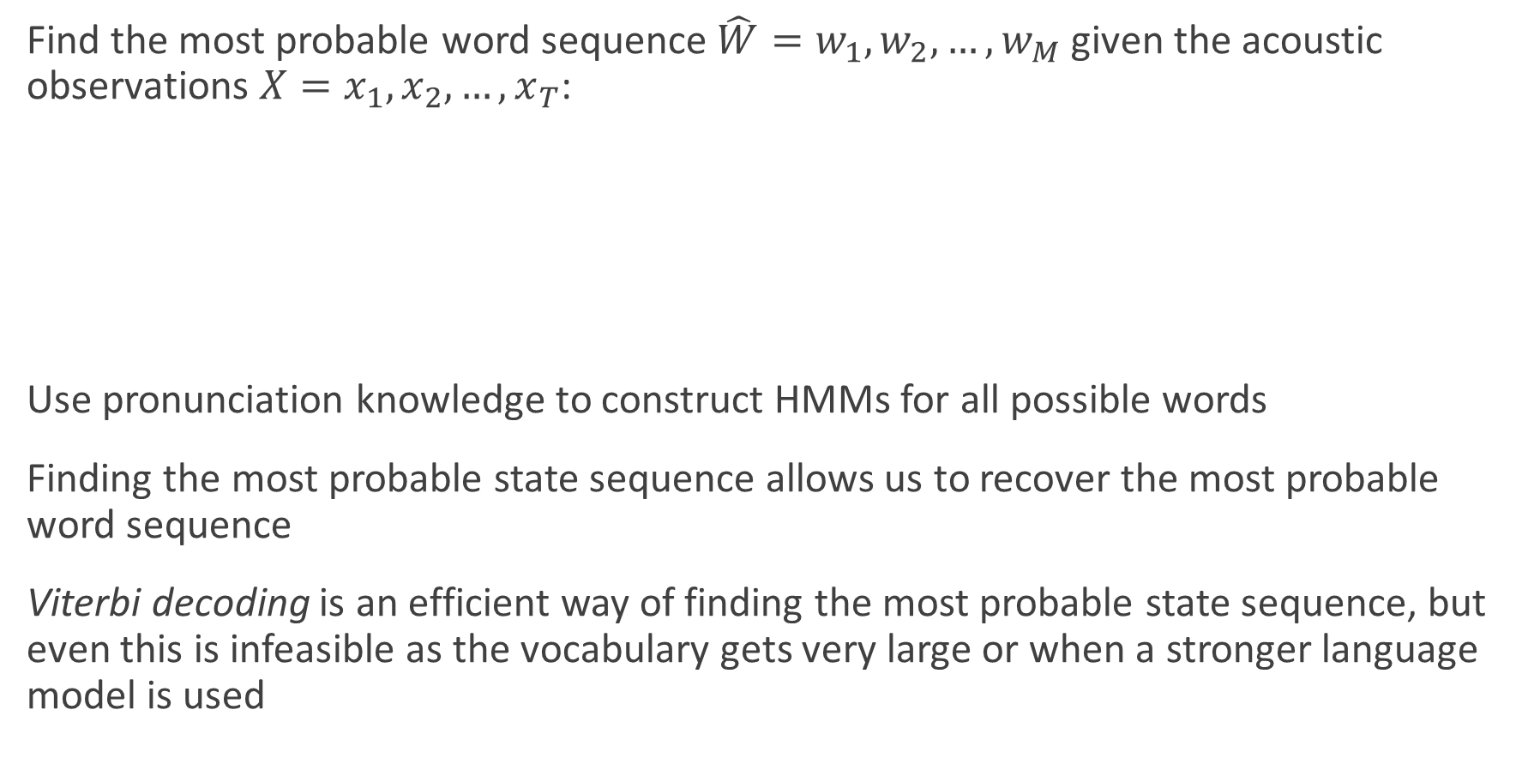
The Search Problem in ASR
Find the most probable word sequence $\hat{W}=w_{1},w_{2},…,w_{M}$ given the acoustic observations $X=x_{1},x_{2},…,x_{T}$:
Use pronunciation knowledge to construct HMMs for all possible words
Finding the most probable state sequence allows us to recover the most probable word sequence
Viterbi decoding is an efficient way of finding the most probable state sequence, but even this is infeasible as the vocabulary gets very large or when a stronger language model is used
$$\hat{W}=\arg{\max_{W}{P(W|X)}}$$
$$=\arg{\max_{W}{p\left(X | W\right)P(W)}}$$
Acoustic model
Language model

